Slide 1
Math 152 – Lesson 5
Lesson | Topic | Reading
4 | Approximate Integration | 7.7
5 | The Fundamental Theorem of Calculus | 5.3
6 | Indefinite Integral and the Net Change Theorem | 5.4
Objectives:
Explain the Fundamental Theorem of Calculus in the context of a real world scenario
Apply the FTC to evaluate definite integrals

Slide 2
Lesson 4 Refresher
If f is the function whose graph is shown in Figure 2 and find the values of g(0), g(1), g(2), g(3), g(4), and g(5). Then sketch a rough graph of g.
= g’(t)
g(t) = position
g‘(t) = velocity
g‘’(t) = acceleration
g(t)
g”(t)
( + )
( 0 )
( - )
( + )
Figure 2
Notes:
Areas: approx +1, +2, +1.3, -1.3, -1.3

Slide 3
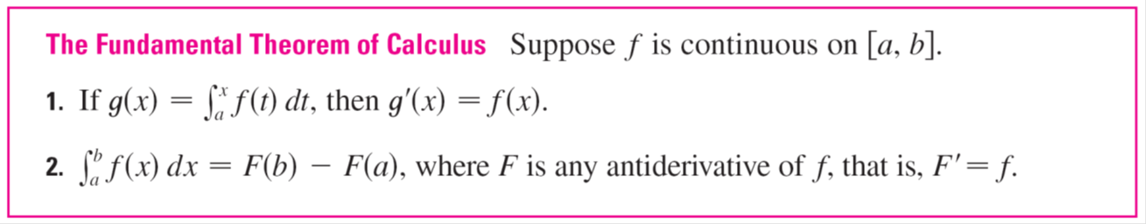
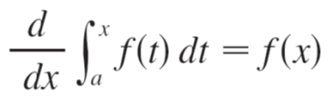
Fundamental Theorem of Calculus (FTC)
FTC connects: differential calculus & integral calculus
Note: from a to x
Note: d/dx operator cancels integral operator
x is a variable, not fixed, and describes the area so far

Slide 4
Fundamental Theorem of Calculus (FTC)
FTC connects: differential calculus & integral calculus
Derivative (Antiderivative) = original function
or
Derivative (Integral) = original function
or
Integral (derivative) = original function
Reversible Process

Slide 5
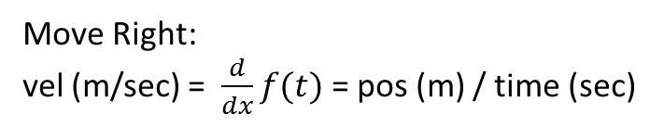
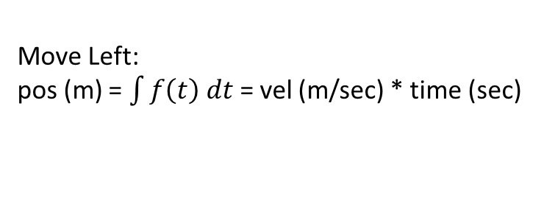
Another Way to Think About It
Position
f(t)
Velocity
f'(t)
Acceleration
f‘'(t)
Derivative
Move Right:
vel (m/sec) = $\frac{d}{dx}f(t)$ = pos (m) / time (sec)
Move Left:
pos (m) = $\int{f\left(t\right) dt}$= vel (m/sec) * time (sec)
Integral
(Antiderivative)

Slide 6
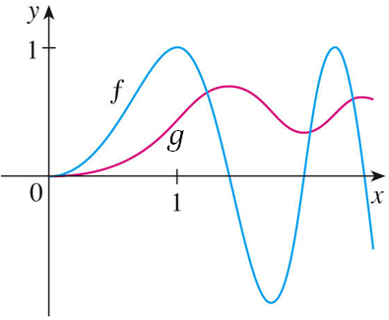
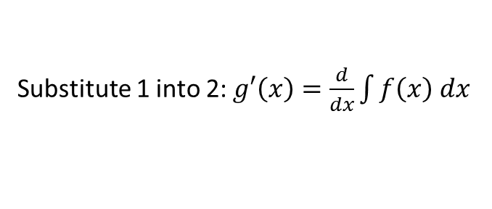
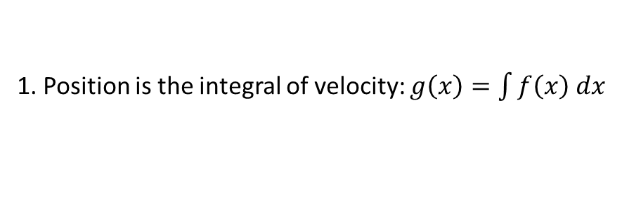
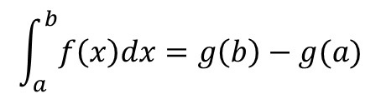

FTC shown another way
1. Position is the integral of velocity: $g\left(x\right)=\int{f\left(x\right) dx}$
2. Velocity is the derivative of position: $g′\left(x\right)=\frac{d}{dx}g(x)$
Substitute 1 into 2: $g′\left(x\right)=\frac{d}{dx}\int{f\left(x\right) dx}$
Vel = vel: $g^{′}\left(x\right)=f(x)$
f(t) = velocity
g(t) = position and antiderivative of f(t)
g‘(t) = velocity
a
b
$$\int_{a}^{b}{f\left(x\right)dx=g\left(b\right)−g(a)}$$
Notes:
Calculate the change of f(x) from a to b
You could compute the area under f(x)
Or
Take the integral/anti-derivative of f(x) – g(x) – and calculate g(b) – g(a)

Slide 7
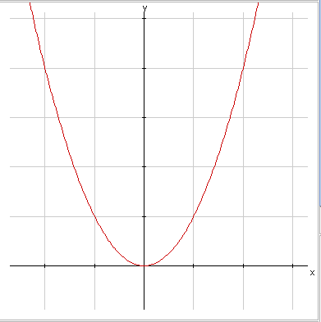
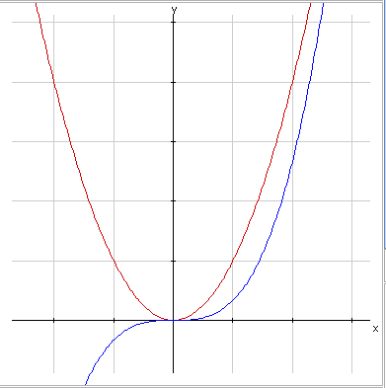
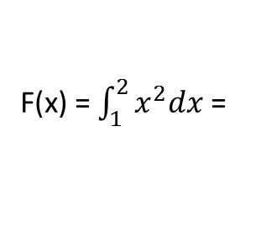

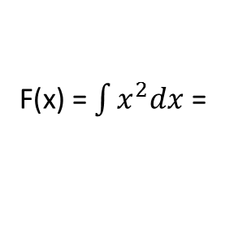





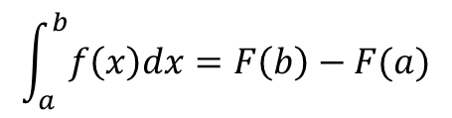
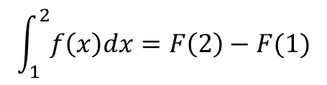
Example
f(x) = $x^{2}$, find area from 1 to 2
Estimate: 1x1 + $\frac{1}{2}(1x3)=2.5$
F(x) = $\int{x^{2}dx}$ =
${(\frac{1}{3})x}^{3}$ + C
Knowing:
$$\int_{a}^{b}{f\left(x\right)dx=F\left(b\right)−F(a)}$$
$$\int_{1}^{2}{f\left(x\right)dx=F\left(2\right)−F(1)}$$
F(x) = $\int_{1}^{2}{x^{2}dx}$ =
${[\left(\frac{1}{3}\right)2}^{3}$ + C]
- ${[\left(\frac{1}{3}\right)1}^{3}$ + C]
= $\frac{8}{3}$ – $\frac{1}{3}=\frac{7}{3}=2.33…$
Notes:
Rough estimate = 1*1 + (1/2)*1*3) = 2.5
The area under the curve, f(x) is 7/3
Note: the “C” cancels…making part II “any anti-derivative “

Slide 8
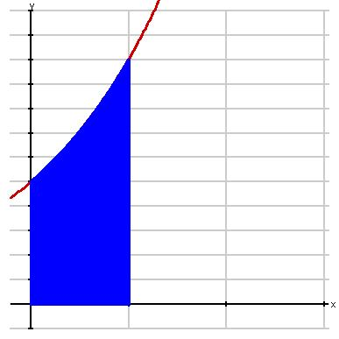
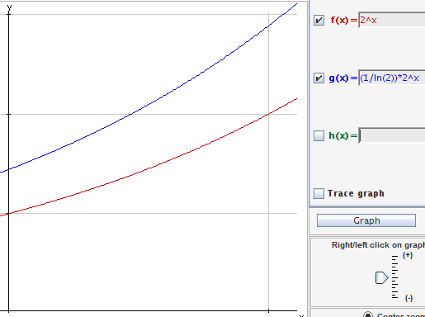
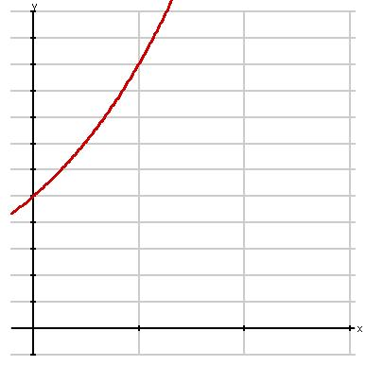
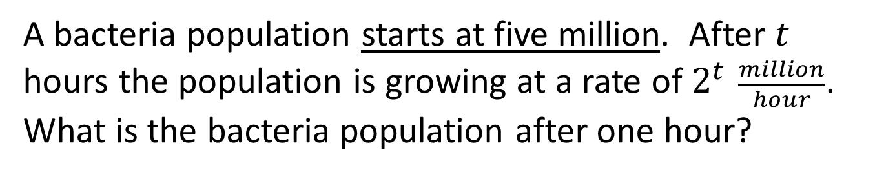
The Definite Integral of a Rate of Change
A bacteria population starts at five million. After $t$ hours the population is growing at a rate of $2^{t} \frac{million}{hour}$. What is the bacteria population after one hour?
Notes:
Graphic estimate: 1.5
Let p(t) = population growth, P’(t) = p(t)
-Integral/Anti-derivative of p(t): P(t) = 1/ln(2) x 2^t + C
given P(0) = 5, C = 5-1/ln(2)
-Integrate from 0 to 1
[1/ln(2) x 2^1 + (5-1/ln(2))] - [1/ln(2) x 2^0 + (5-1/ln(2))]
= 1/ln(2)(2-1) = 1.44…the change from t=0 to t=1
- P(1) = 1/ln(2) x 2^1 + (5-1/ln(2)) = 5 + (2-1)/ln(2) = 6.44

Slide 9
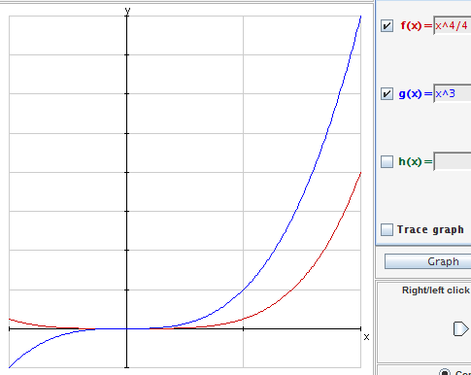
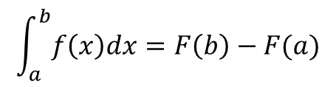
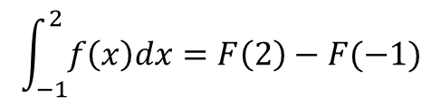
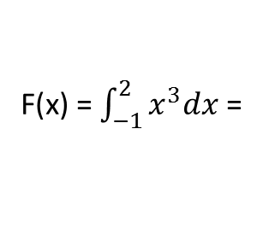





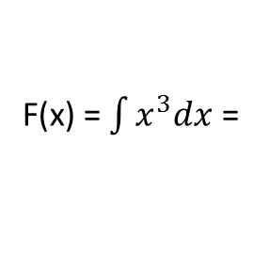

5.3, #53
f(x) = $x^{3}$, find area from -1 to 2
Estimate: 1x1 + $\frac{1}{2}(1x7)=4.5$
f(x)
F(x) = $\int{x^{3}dx}$ =
${(\frac{1}{4})x}^{4}$ + C
& Knowing:
F(x)
$$\int_{a}^{b}{f\left(x\right)dx=F\left(b\right)−F(a)}$$
$$\int_{−1}^{2}{f\left(x\right)dx=F\left(2\right)−F(−1)}$$
F(x) = $\int_{−1}^{2}{x^{3}dx}$ =
${[\left(\frac{1}{4}\right)2}^{4}$ + C]
- ${[\left(\frac{1}{4}\right)(−1)}^{4}$ + C]
= $\frac{16}{4}$ – $\frac{1}{4}=\frac{15}{4}=3.75…$
Notes:
In the estimate, the two smaller triangles cancel out, and the large triangle is an overestimate… 0.75 actually

Slide 10
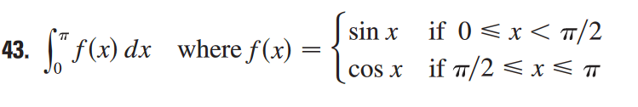
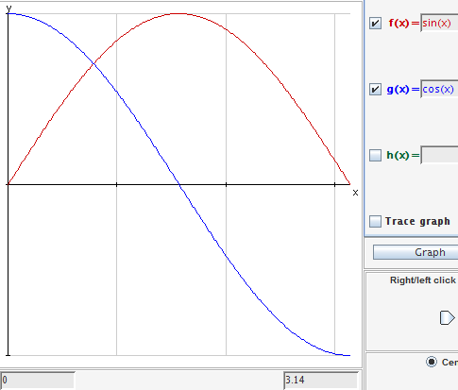
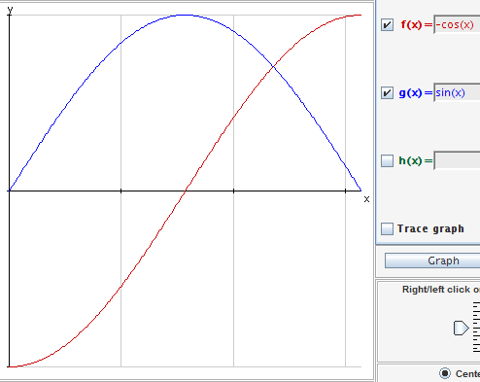

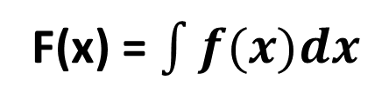


5.3, #43
$$\frac{π}{2}$$
$$f(x)$$
$$\frac{π}{2}$$
F(x) = $\int{f(x)dx}$
Notes:
(0 - - 1) + (0 – 1) = 0

Slide 11
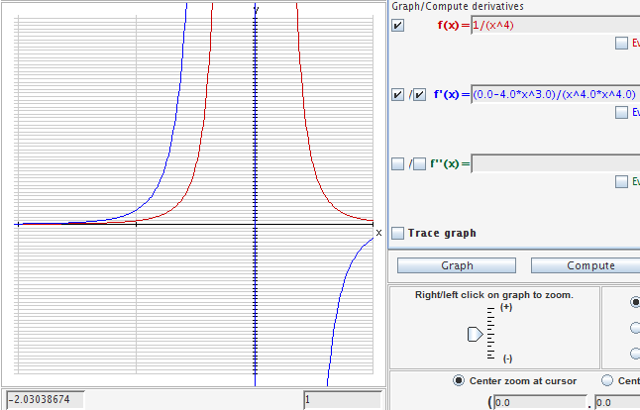
5.3, #45
Notes:
1/x^4 is not continuous from -2 to 1, therefore FToC is NA

Slide 12
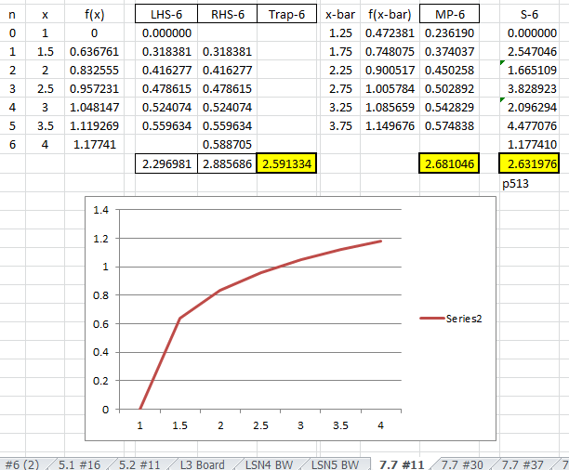
7.7 #11, f(x) = SQRT(LN(x))

Slide 14


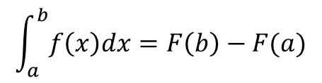
FTC in Context of a Scenario
Explain in words what the integral represents and give units:
1) $\int_{0}^{6}{a\left(t\right)dt}$, where $a(t)$ is acceleration in ${km}/{{hr}^{2}}$ and $t$ is time in hours.
2) $\int_{2000}^{2004}{f\left(t\right)dt}$, where $f(t)$ is the rate at which the world’s population is growing in year $t$, in billion people per year.
$$\int_{a}^{b}{f\left(x\right)dx=F\left(b\right)−F(a)}$$
Where $F$ is any antiderivative of $f$
Notes:
-Change in velocity between start and six hours (km/hr)
-Difference in population between 2000 2004

Slide 15
Differentiation and Integration as Inverse Processes
We end this section by bringing together the two parts of the Fundamental Theorem.
We noted that Part 1 can be rewritten as
which says that if f is integrated and then the result is differentiated, we arrive back at the original function f.

Slide 16
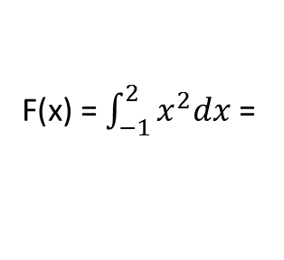
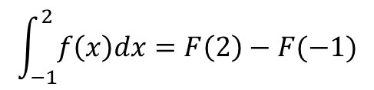
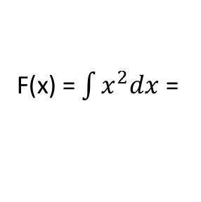




f(x) = $x^{2}$, find area from -1 to 2
F(x) = $\int{x^{2}dx}$ =
${(\frac{1}{3})x}^{3}$ + C
Knowing:
$$\int_{a}^{b}{f\left(x\right)dx=F\left(b\right)−F(a)}$$
$$\int_{−1}^{2}{f\left(x\right)dx=F\left(2\right)−F(−1)}$$
F(x) = $\int_{−1}^{2}{x^{2}dx}$ =
${[\left(\frac{1}{3}\right)2}^{3}$ + C]
- ${[\left(\frac{1}{3}\right)(−1)}^{3}$ + C]
= $\frac{8}{3}$ + $\frac{1}{3}=\frac{9}{3}=3$
Notes:
Rough estimate = 1*1 + (1/2)*1*3) = 2.5
The area under the curve, f(x) is 7/3
Note: the “C” cancels…making part II “any anti-derivative “

Slide 17

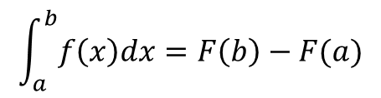




Fundamental Theorem of Calculus
Part I
$$If f is continuous on \left[a,b\right] and$$
$$g\left(x\right)=\int_{a}^{x}{f\left(t\right) dt}$$
$Then g is continuous and$
$differentiable on \left[a,b\right] and$
$$g^{′}\left(x\right)=f(x)$$
Part II
g(x)
$$\int_{a}^{b}{f\left(x\right)dx=F\left(b\right)−F(a)}$$
( + )
( - )
( + )
( - )
g”(x)
Where $F$ is any antiderivative of $f$
Notes:
Part I is mostly a setup for Part II
Proof on page 388
]
Take the anti-derivative of f to get a plot of g.
Use the derivative of f (g”) to get the curvature of g(x)
Use the area under the f-curve to find the value of g(x)
Notes: IF f is continuous…need to show that f is continuous
F is not automatically the anti-derivative of f…only if you define it as such.

Slide 18
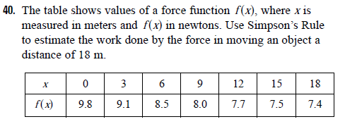
HW Problem
Notes:
When we take the limit of such Riemann sums, we get the situation illustrated.
A definite integral can be interpreted as a net area, that is, a difference of areas where A₁ is the area of the region above the x-axis and below the graph of f, and A₂ is the area of the region below the x-axis and above the graph of f.

Slide 19
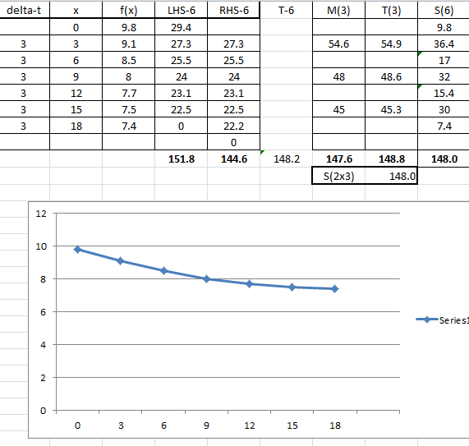

Slide 20
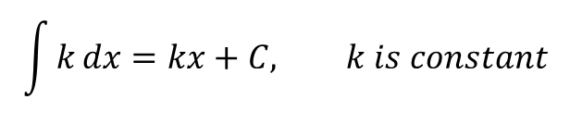
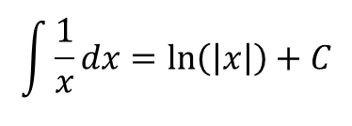
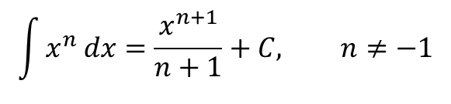
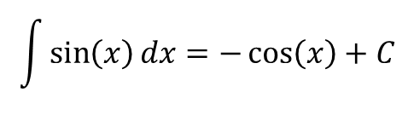
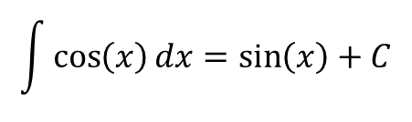
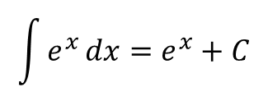
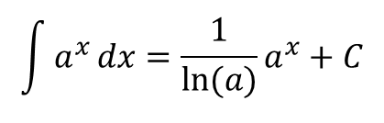
Review
$$\int{k}dx=kx+C, k is constant$$
$$\int{x^{n}}dx=\frac{x^{n+1}}{n+1}+C, n≠−1$$
$$\int{\frac{1}{x}}dx=\ln\left(\left|x\right|\right)+C$$
$$\int{a^{x}}dx={\frac{1}{\ln{(a)}}a}^{x}+C$$
$$\int{e^{x}}dx=e^{x}+C$$
$$\int{\cos\left(x\right)}dx=\sin\left(x\right)+C$$
$$\int{\sin\left(x\right)}dx=−\cos\left(x\right)+C$$

Slide 21

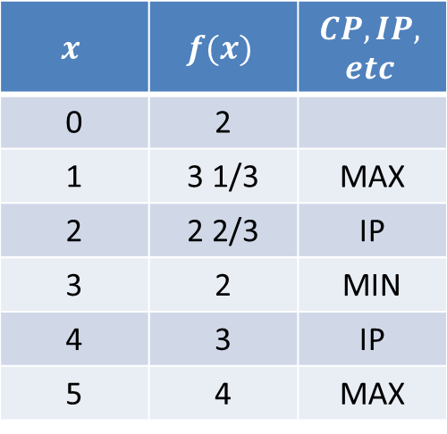


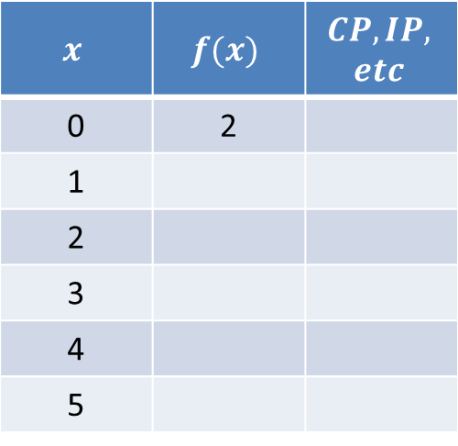
Graphing Anti-derivatives
$$x$$ | $$f(x)$$ | $$CP,IP,$$ $$etc$$
0 | 2
1
2
3
4
5
$$x$$ | $$f(x)$$ | $$CP,IP,$$ $$etc$$
0 | 2
1 | 3 1/3 | MAX
2 | 2 2/3 | IP
3 | 2 | MIN
4 | 3 | IP
5 | 4 | MAX
$$f′(x)$$
Area = 2
Area = 4/3
Area = 4/3
$$f(x)$$
$$( − )$$
$$( + )$$
$$( − )$$
$$f"(x)$$
Notes:
0
2
NA
1
$3\frac{1}{3}$
Max
2
$2\frac{2}{3}$
IP (DU)
3
2
Min
4
3
IP(UD)
5
4
Max

Slide 22
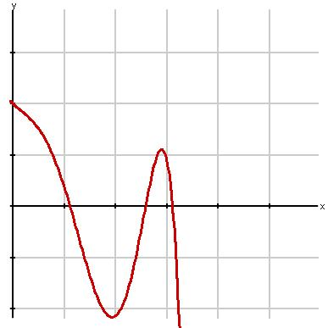
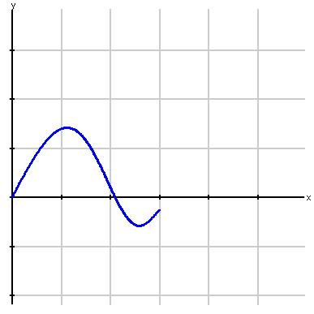
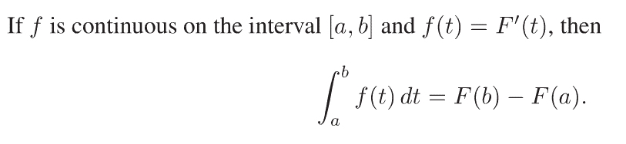

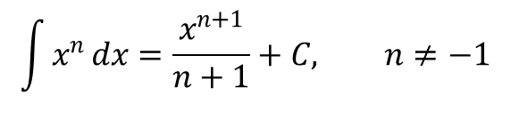









Fundamental Theorem of Calculus, Pt2
$$f(t)$$
$$F(t)$$
$$F^{′}\left(t\right)$$
$$=$$
$$f(t)$$
$$t$$
$$t$$
$$Velocity$$
$$Distance$$
$$\lim_{n→∞}{\sum_{i=1}^{n}{f\left(t_{i}\right)∆t =} }\int_{a}^{b}{f\left(t\right)dt}$$
$$\lim_{n→∞}{\sum_{i=1}^{n}{f\left(t_{i}\right)∆t =} }\int_{a}^{b}{f\left(t\right)dt}$$
$$\sum_{i=1}^{n}{f\left(t_{i}\right)∆t}$$
$$\sum_{i=1}^{n}{f\left(t_{i}\right)∆t}$$
Total distance traveled between t=a and t=b
Total distance traveled between t=a and t=b
$$= F\left(b\right)−F(a)$$
$$=$$
$$=$$
$$The Fundamental Theorem of Calculus, Part 2$$

Slide 23

f(t) = 9/(1+t^2+t^4)

